Slide 1



Boom Bikes
Bike Sharing
This company provide share bike service on short term basis to common people.
Presented By: Balakumar Seethapathy
01
02
03
Challenges
Solution
Results
Company recently affected by pandemic and needs to do mindful business plan and accelerate revenue
Company aspires to understand the demand for shared bikes and get prepared in better way to yield more profit in optimized way.
Linear Regression model is built to understand various factors that affect bike sharing business and to predict future demand.

Slide 2
Problem Solving Approach and Methodology
Explore Data
Prepare Data Model
Residual Analysis
We explored data to know range, data type and identified useful metrics.
Encoding- One Hot Technique
2. Split data into train and test data.
3. Scaling features.
Perform Residual Analysis to make error terms are constant and normally distributed.
Visualize Data
Train the model
Prediction & Evaluation
Exploratory Data Analysis: Visualizing the Data with help of scatter plot and correlation to understand high positive and negative impact attributes
Train the model with stats model api iteratively.
Fit the model to test data and verify the R-Squared value and plot graph between predicted and actual target variable.

Slide 3
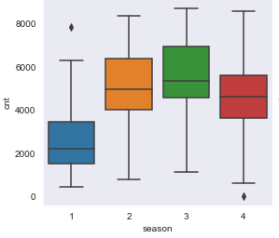
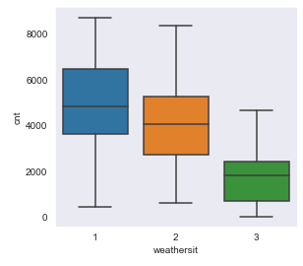
Outcomes: Exploring & Visualize Data
Seasonal Aspect, Demand is: 1:spring, 2:summer, 3:fall, 4:winter
High in Summer and Fall
Average in Winter
Low in Spring
Weather Situation, Demand is: 1: Clear Sky, 2: Cloudy, 3: Light Snow
High on Clear, Partly Cloudy days
Average on Misty, Cloudy days
Low on Snow and Rainy days

Slide 4
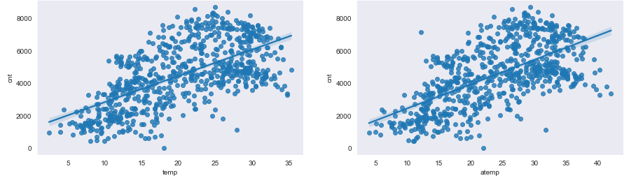
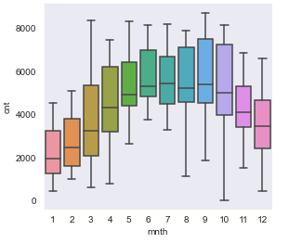
Outcomes: Exploring & Visualize Data
Temperature and feels like temperature, Demand:
Surges as temperature rises
Month Aspect, Demand:
Peak near month of May, June, July, August September
Tapers on either side of the year w.r.t above months.

Slide 5
Procedure and Boundaries
Remove the following variables as it has no impact on outcome:
instant, dteday, casual, registered, temp
Encoding: One-hot technique is performed on following columns:
season, mnth, weekday, weathersit
Scaling: Min-Max scaling is performed on the dataset.
Data Split – Given data set is split into 50% - training and 50% - test
Multiple Linear Regression – Stats Model API is used here to build the model.
Conditions observed while dropping features in iterative fashion:
VIF > 6.5 dropped (Industry standard practice few consider below 10 is good, but conservative models look at 5 as critical value for banking and healthcare related ones. Here I have chosen average at 6.5 as critical value for VIF)
p-Value > 0.05 dropped

Slide 6
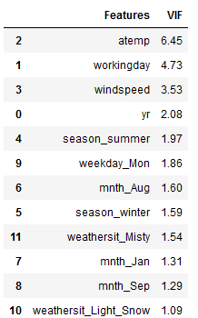
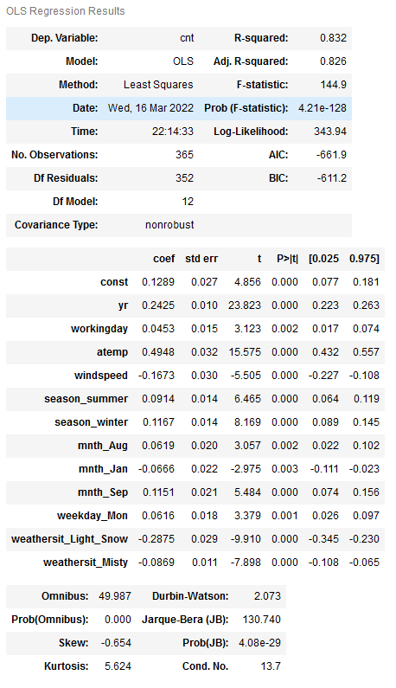
Trained Model Metrics

Slide 7
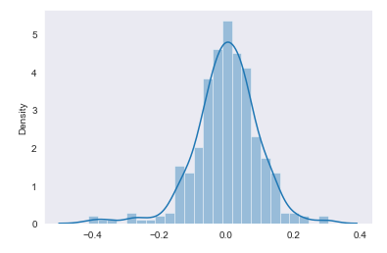
Residual Analysis – Trained Data

Slide 8
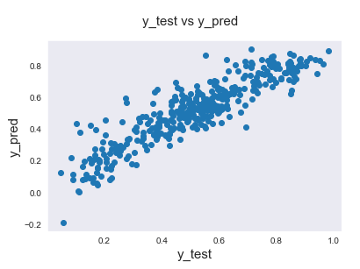
Model Evaluation
0.8099713060806867
R-Square on test data: 0.8099713060806867
R-Square on train data: 0.832

Slide 9
Multiple Linear Regression Equation
Positive Impact | Negative Impact
Temperature Feels Like | Light Snow
Summer | Misty weather
Winter | Wind Speed
August- Month | January
September- Month
Monday
Winter
Working Day
cnt = 0.1289
+ 0.2425*yr
+ 0.0453*workingday
+ 0.4948*atemp
+ 0.0914*season_summer
+ 0.1167*season_winter
+ 0.0619*mnth_Aug
+ 0.1151*mnth_Sep
+ 0.0616*weekday_Mon
- 0.2875*weathersit_Light_Snow
- 0.0869*weathersit_Misty
- 0.1673*windspeed
- 0.0666*mnth_Jan

